Slide 1
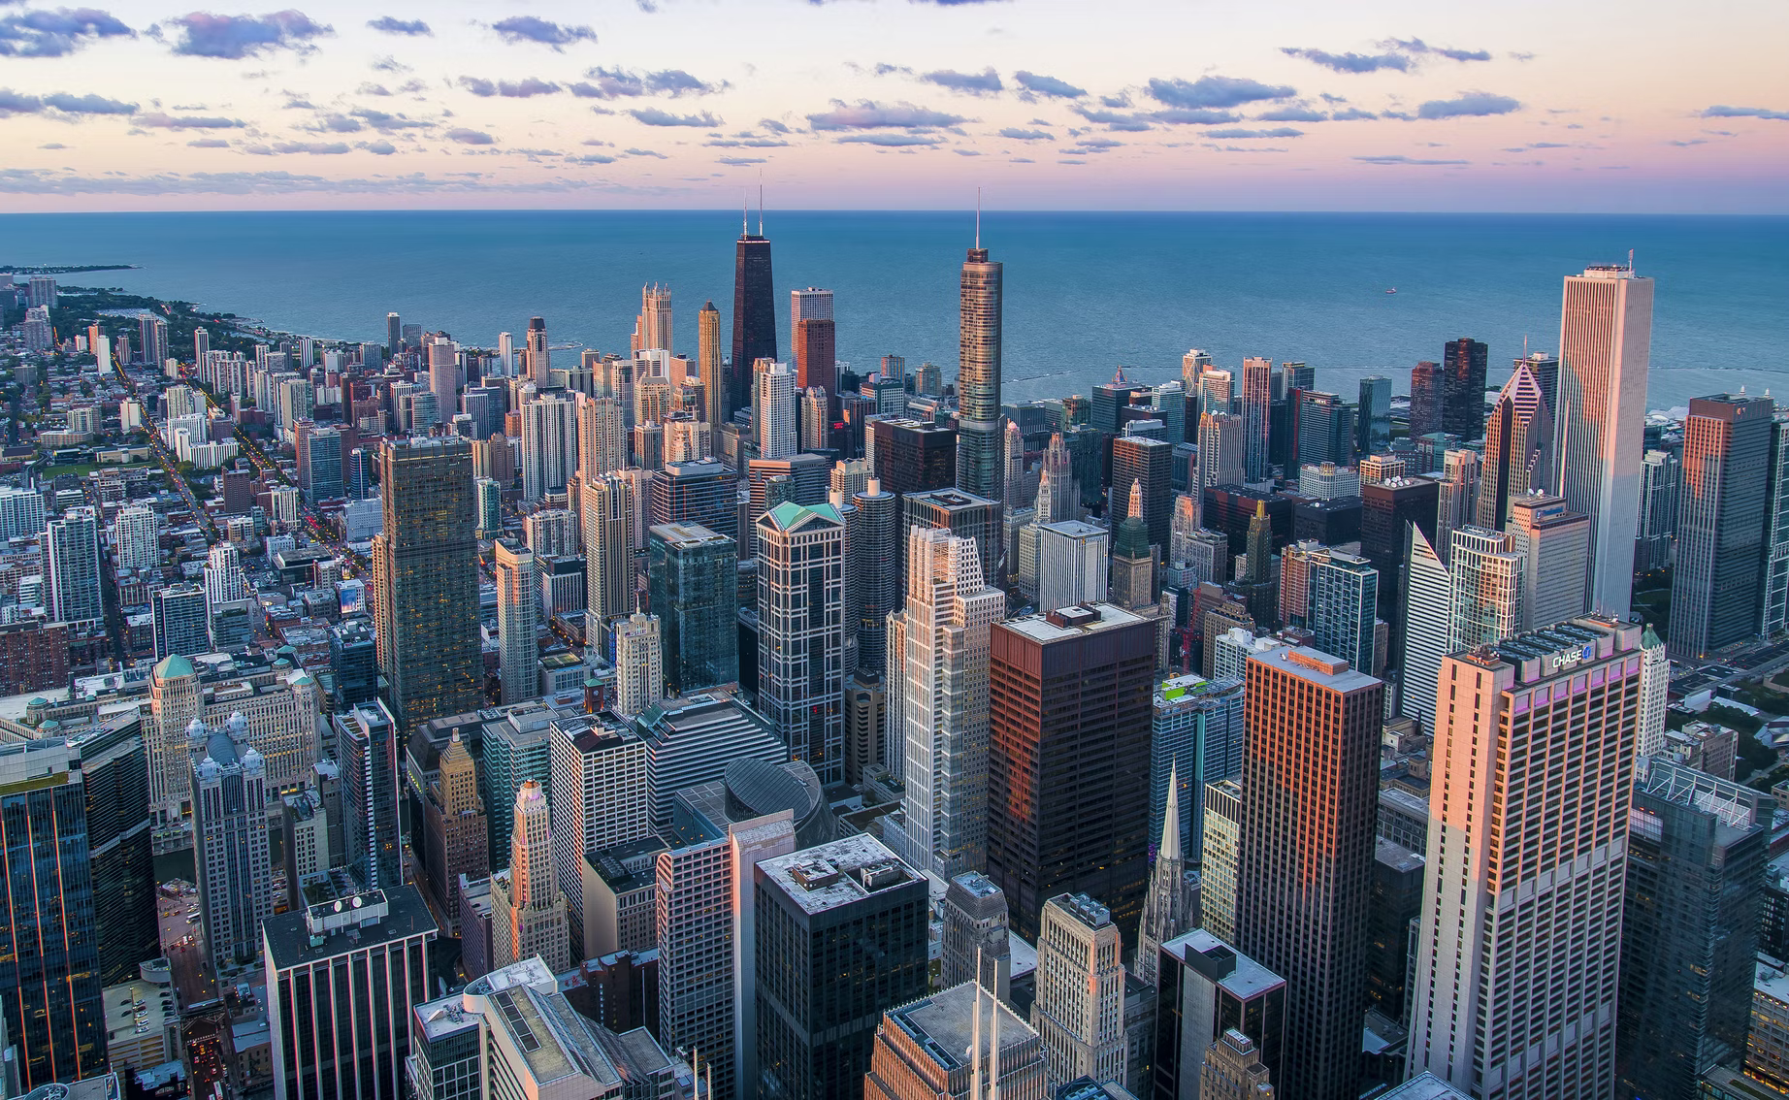
DATA ANALYTICS PYTHON
FINAL PROJECT PORTFOLIO
MUHAMMAD WAHFIUDDIN PRADIWA

Slide 2
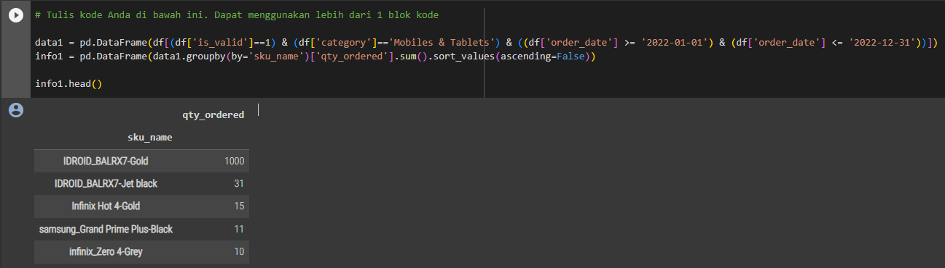
QUESTION 1

Slide 3
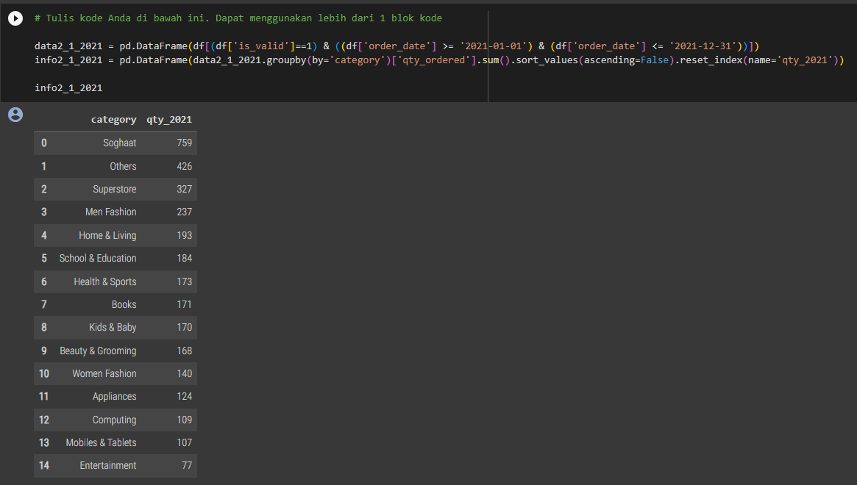
QUESTION 2.1

Slide 4
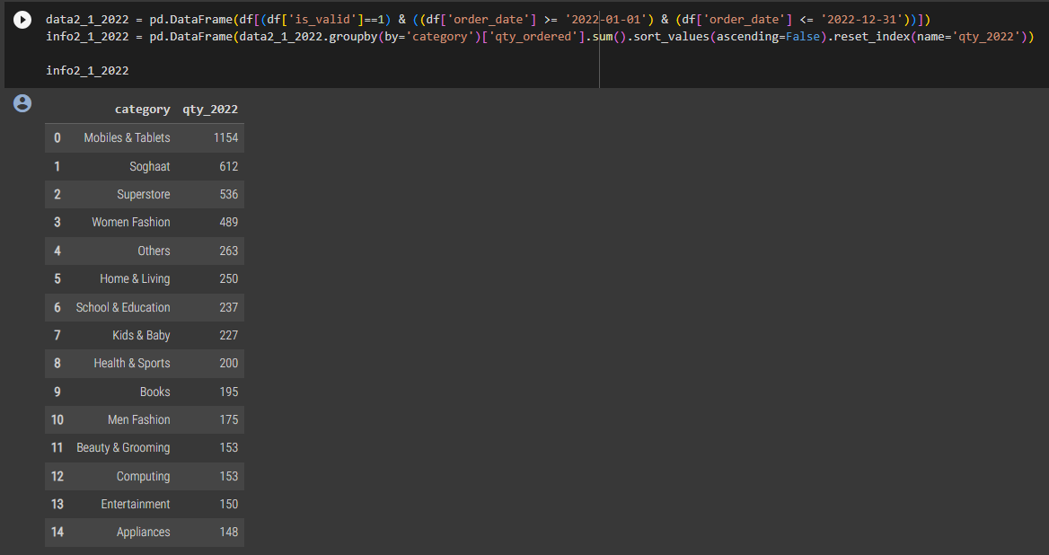
QUESTION 2.1

Slide 5
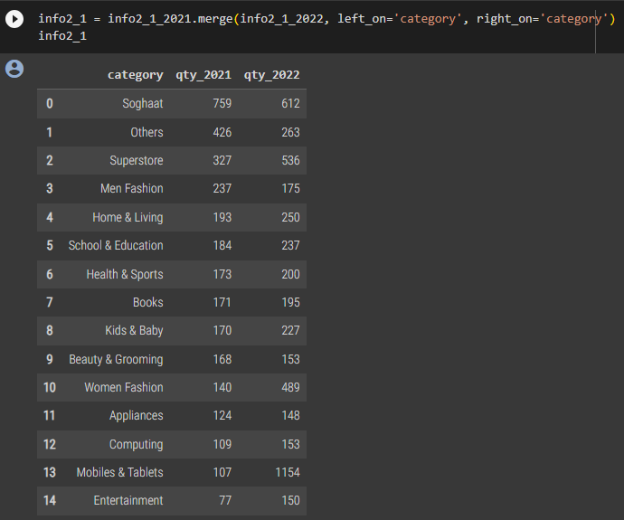
QUESTION 2.1

Slide 6
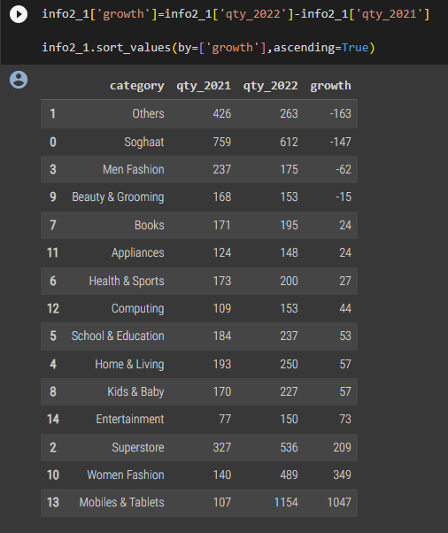
QUESTION 2.1

Slide 7
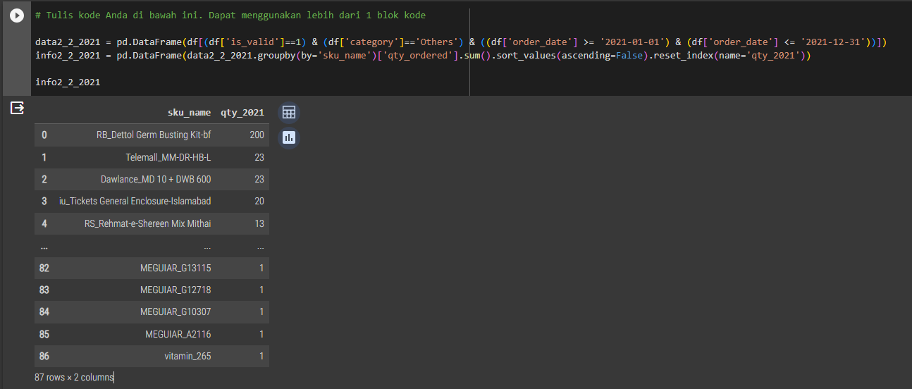
QUESTION 2.2

Slide 8
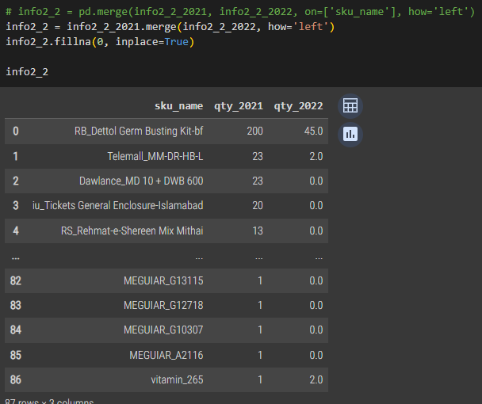
QUESTION 2.2

Slide 9
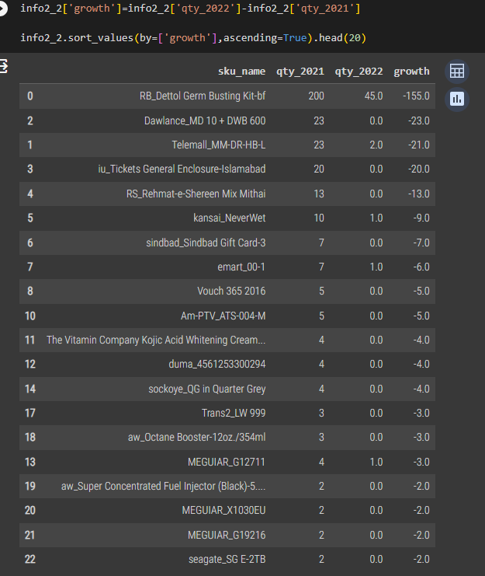
QUESTION 2.2

Slide 10
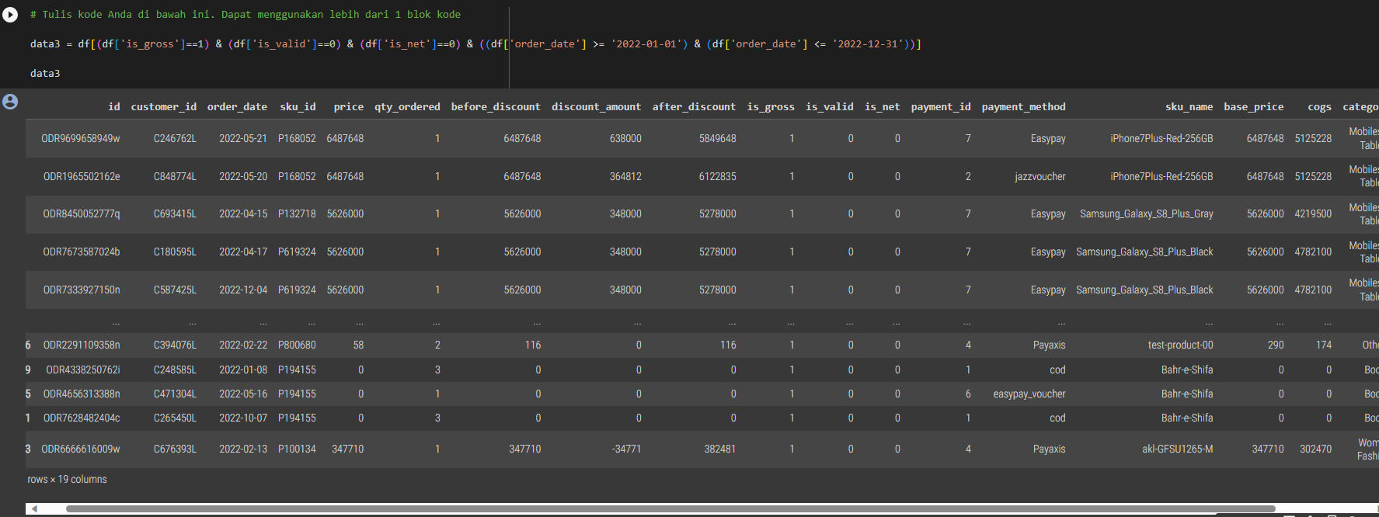
QUESTION 3

Slide 11
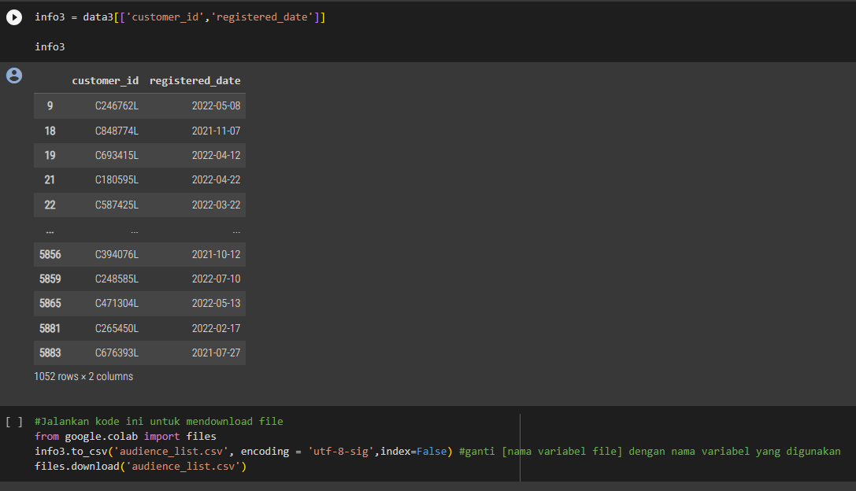
QUESTION 3

Slide 12
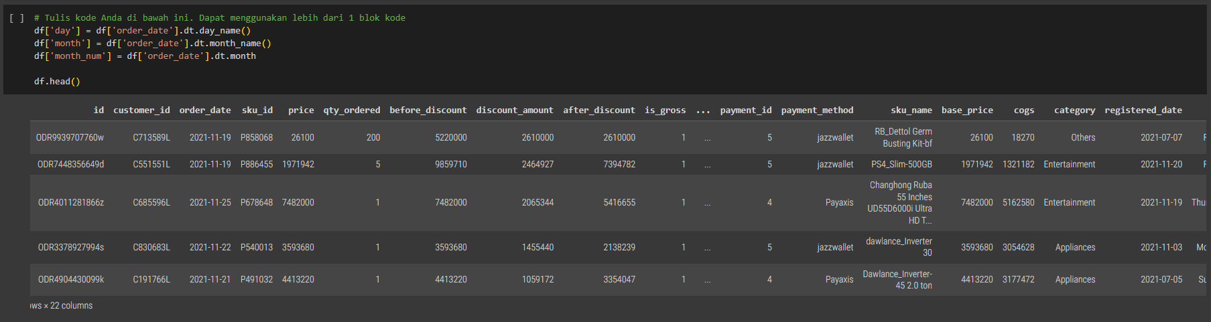
QUESTION 4.1

Slide 13
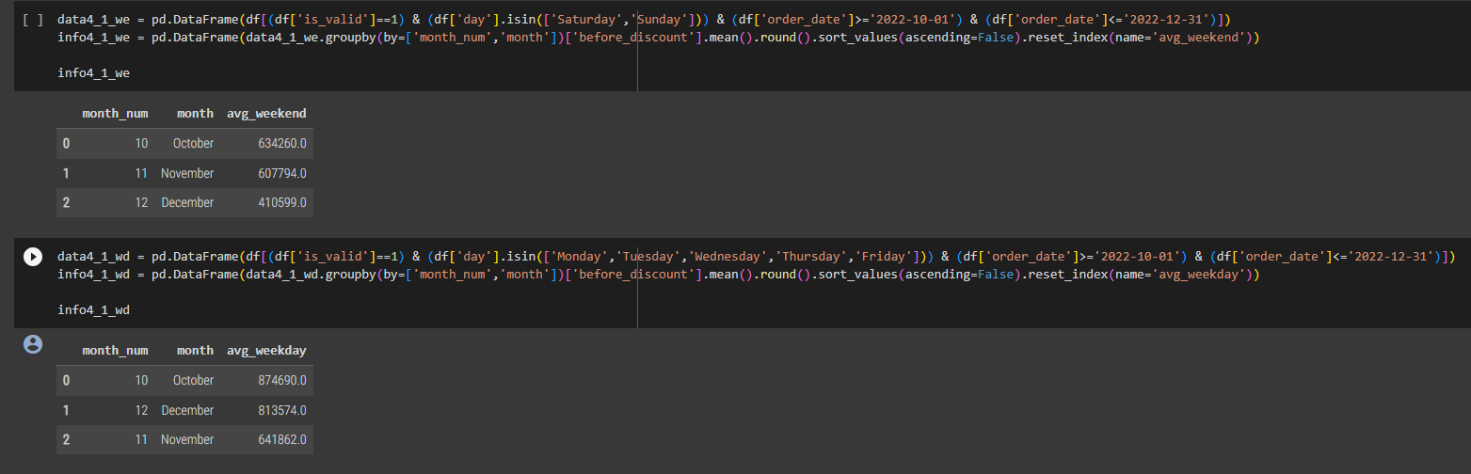
QUESTION 4.1

Slide 14
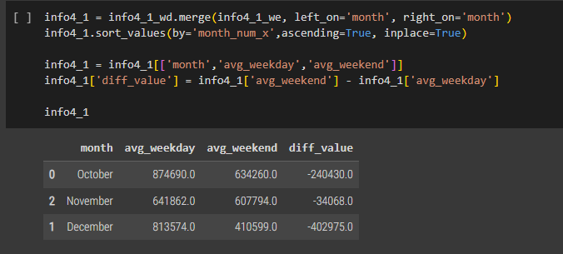
QUESTION 4.1

Slide 15
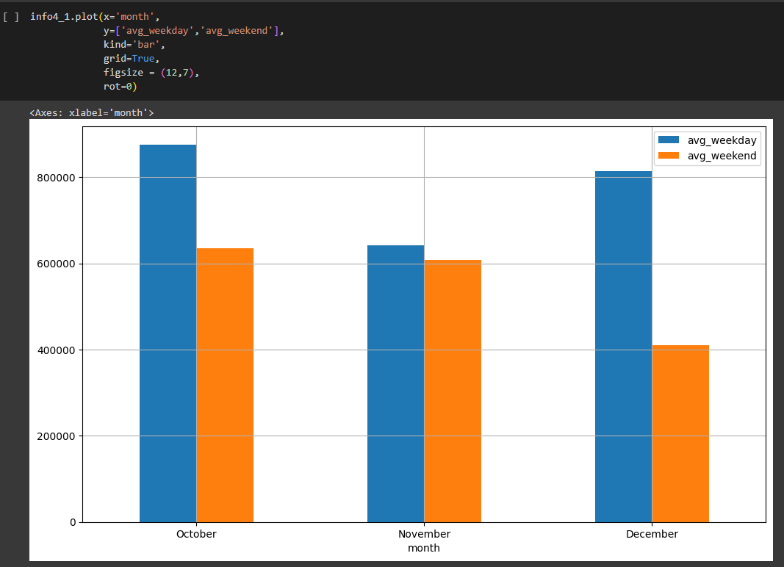
QUESTION 4.1

Slide 16
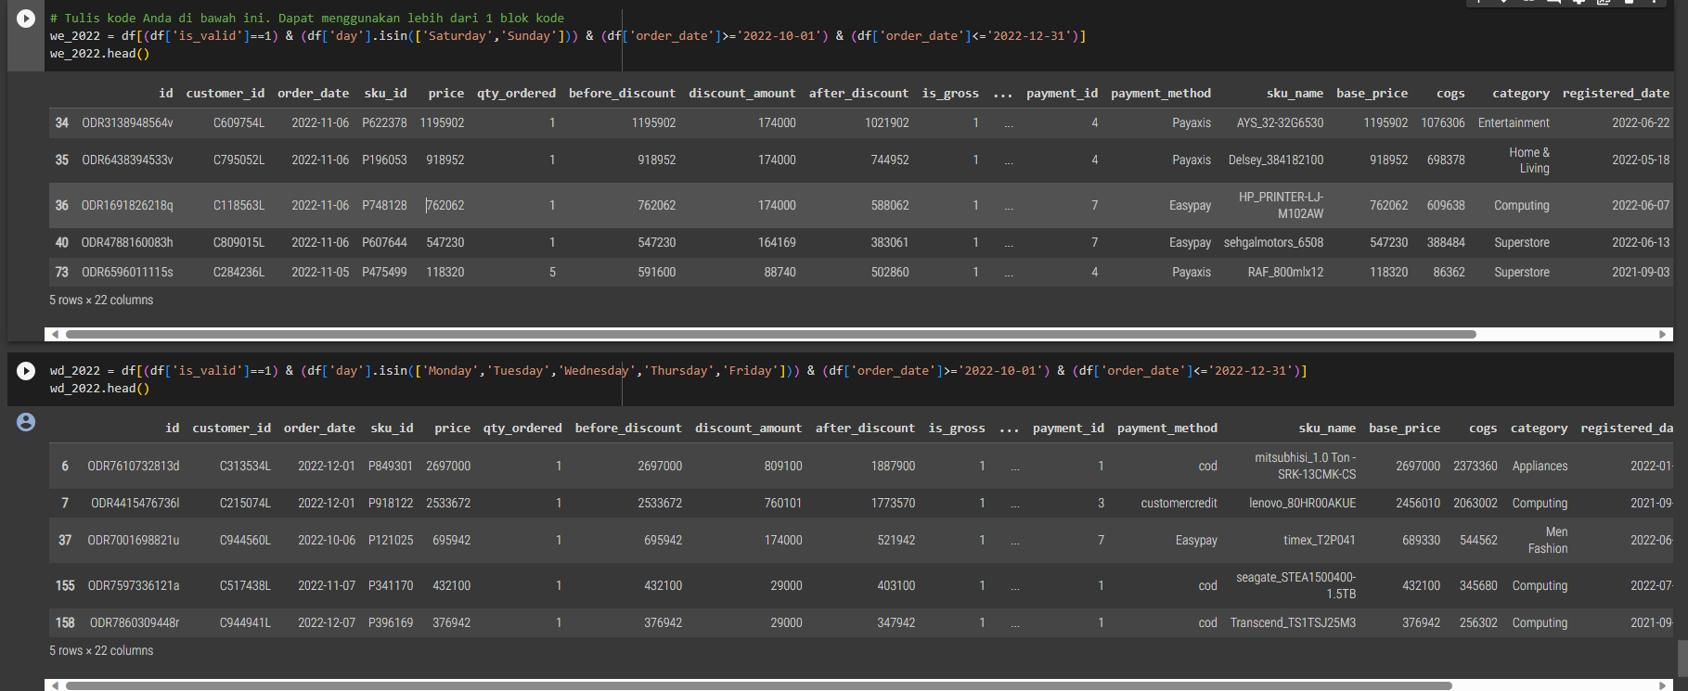
QUESTION 4.2

Slide 17
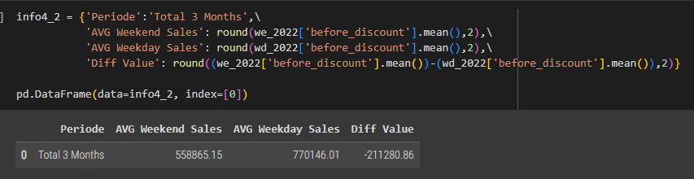
QUESTION 4.2

Slide 18
TERIMA KASIH

